Slide 1
CSE 4128 Lab 2
Topic: Smoothing Using Bilateral Filter
Dr. Sk. Md. Masudul Ahsan
Professor,
Dept. of Computer Science and Engineering,
KUET
Dipannita Biswas
Lecturer,
Dept. of Computer Science and Engineering,
KUET
Kaniz Fatema Isha
Lecturer,
Dept. of Computer Science and Engineering,
KUET

Slide 2
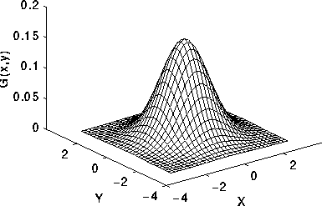
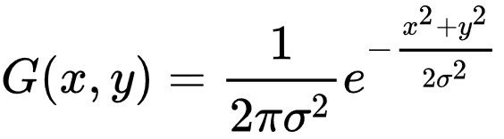
Gaussian Function
where x is the distance from the origin in the horizontal axis, y is the distance from the origin in the vertical axis, and σ is the standard deviation of the Gaussian distribution.
2-D Gaussian distribution with mean (0,0) and σ =1

Slide 3
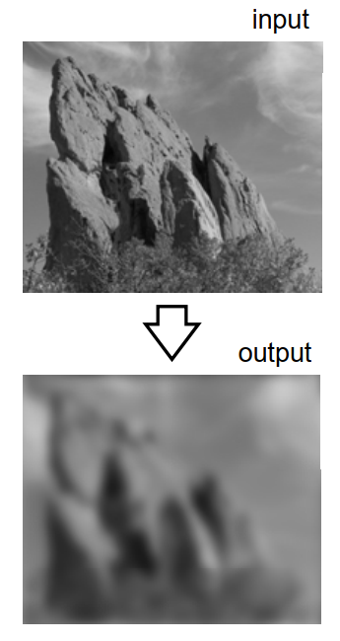
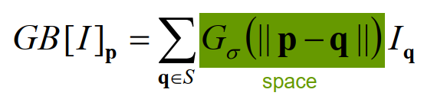
Properties of Gaussian Blur
While smoothing:
Edges are blurred
Only Spatial distance matters

Slide 4
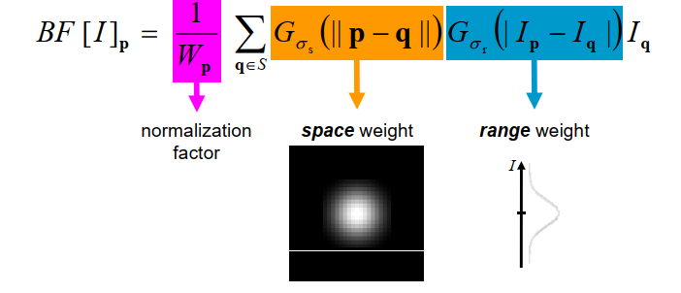
Bilateral Filter
A bilateral filter is a non-linear, edge-preserving, and noise-reducing smoothing filter for images. It replaces the intensity of each pixel with a weighted average of intensity values from nearby pixels

Slide 5
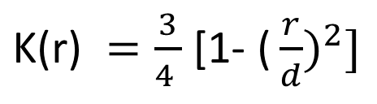
Epanechnikov distribution for spatial domain
Epanechnikov Kernel is a kernel function that is of quadratic form.
q(x_{c},y_{c})
r
$\text{K}\text{(}\text{r}\text{) }=\frac{3}{4 }$ [1- ${\text{(}\frac{r}{d})}^{2}]$
p(x_{c},y_{c})
d
Here, r = distance of pixel q ϵ S from center p of kernel S
d = kernel size / 2
S

Slide 6
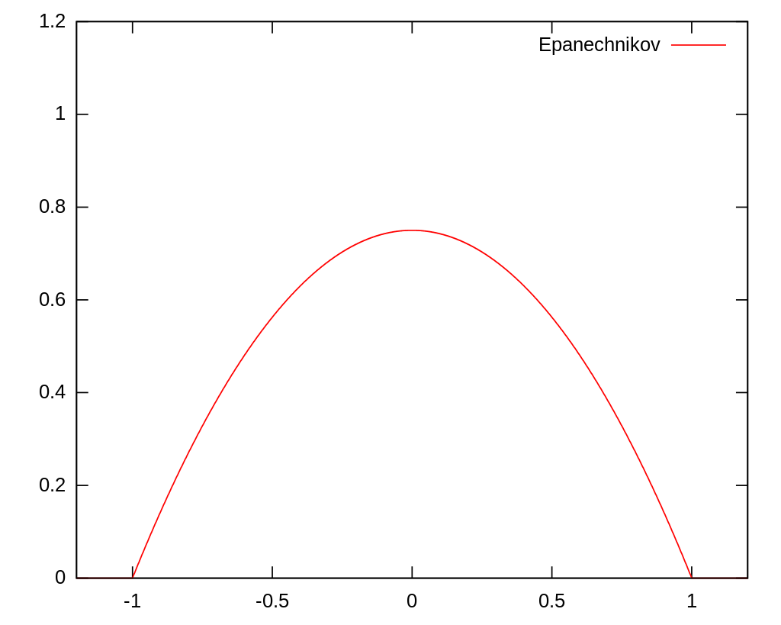
Epanechnikov Curve

Slide 7
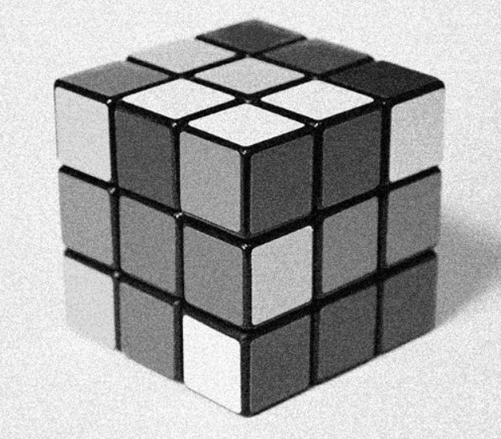
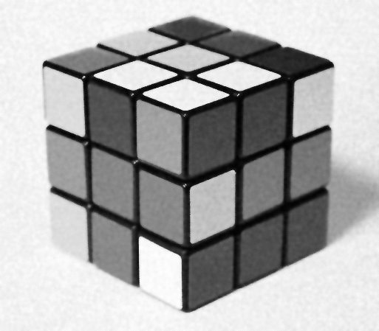

Output using OpenCv Bilateral function
with kernel Diameter = 7
Sigma = 80 for intensity space
Sigma = 20 for coordinate space
Output using Epanechnikov distribution
for coordinate space
with kernel Diameter = 7
Sigma = 80 for intensity space
Input image
cv2.bilateralFilter ( src, dst, kernel, sigmaColor , sigmaSpace , borderType = BORDER_DEFAULT )

Slide 8
Assignment
Convolution as Matrix Multiplication

Slide 9
Convolution as Matrix Multiplication
1. Define Input and Filter
1
2
3
10
20
4
5
6
30
40
Input image
Filter

Slide 10
Convolution as Matrix Multiplication
2. Calculate the final output size
If the Input is m1 x n1 and Filter is m2 x n2 the size of the output will be:
( m1 + m2 - 1) x ( n1 + n2 - 1)
For our example it’s : (2 + 2 - 1) x (3 + 2 - 1)
= 3 x 4

Slide 11
Convolution as Matrix Multiplication
3- Zero Pad the filter matrix
Zero pad the filter to make it the same size as the output.
Zero padded F =
0
0
0
0
10
20
0
0
30
40
0
0

Slide 12
Convolution as Matrix Multiplication
4- Create Toeplitz matrix for each row of the zero-padded filter
0
0
0
0
Zero padded F =
10
20
0
0
30
40
0
0
30
0
0
10
0
0
0
0
0
40
30
0
20
10
0
0
0
0
0
40
30
0
20
10
0
0
0
0
0
40
0
0
20
0
0
0
F0
F1
F2

Slide 13

Convolution as Matrix Multiplication
5- Create a doubly blocked Toeplitz matrix
Now all these small Toeplitz matrices should be arranged in a big doubly blocked Toeplitz matrix.

Slide 14
Convolution as Matrix Multiplication
30
0
0
0
0
0
40
30
0
4
0
0
0
0
40
30
0
0
0
5
0
0
40
0
0
0
10
0
0
30
0
0
Doubly Blocked =
6
20
10
0
40
30
0
0
20
10
0
40
30
1
0
0
20
0
0
40
0
0
0
10
0
0
2
0
0
0
20
10
0
3
0
0
0
0
20
10
0
0
0
0
0
20

Slide 15
Convolution as Matrix Multiplication
6- Convert the input matrix to a column vector
4
5
1
2
3
Vectored
I =
I =
6
4
5
6
1
2
3

Slide 16
Convolution as Matrix Multiplication
7- Multiply doubly blocked Toeplitz matrix with vectorized input signal
This multiplication gives the convolution result.

Slide 17
8- Last step: reshape the result to a matrix form
120
310
380
10
40
70
60
240
70
230
330
240
70
120
310
380
240
230
Output
330
Result Vector
240
10
40
70
60

